Slide 1
CS 7643: Deep Learning
Topics:
Review of Classical Reinforcement Learning
Value-based Deep RL
Policy-based Deep RL
Dhruv Batra
Georgia Tech

Slide 2
Types of Learning
Supervised learning
Learning from a “teacher”
Training data includes desired outputs
Unsupervised learning
Training data does not include desired outputs
Reinforcement learning
Learning to act under evaluative feedback (rewards)

Slide 3
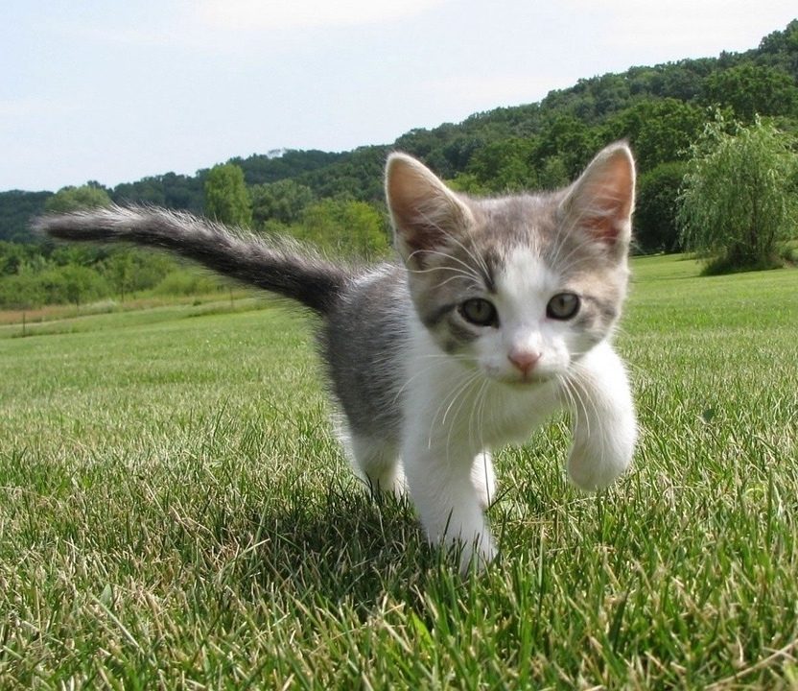
Supervised Learning
Data: (x, y)
x is data, y is label
Goal: Learn a function to map x -> y
Examples: Classification, regression, object detection, semantic segmentation, image captioning, etc.
Cat
Classification
This image is CC0 public domain
Slide Credit: Fei-Fei Li, Justin Johnson, Serena Yeung, CS 231n

Slide 4
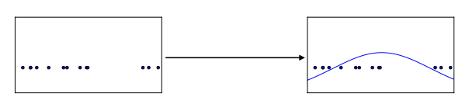
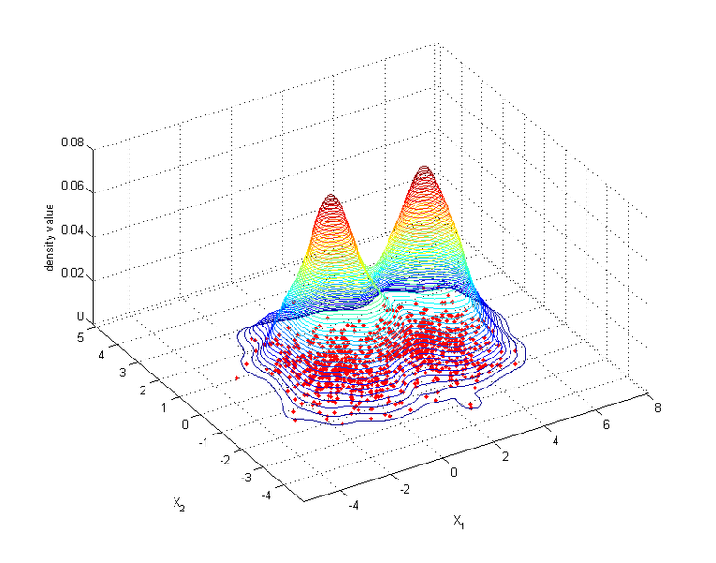
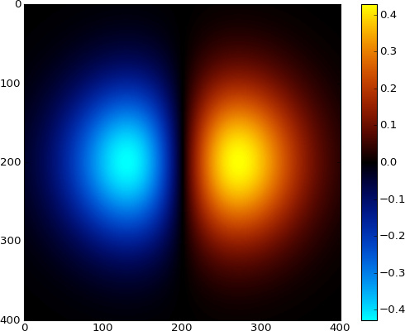
Unsupervised Learning
Data: x
Just data, no labels!
Goal: Learn some underlying hidden structure of the data
Examples: Clustering, dimensionality reduction, feature learning, density estimation, etc.
Figure copyright Ian Goodfellow, 2016. Reproduced with permission.
1-d density estimation
2-d density estimation
2-d density images left and right are CC0 public domain
Slide Credit: Fei-Fei Li, Justin Johnson, Serena Yeung, CS 231n

Slide 5

What is Reinforcement Learning?
Agent-oriented learning—learning by interacting with an environment to achieve a goal
more realistic and ambitious than other kinds of machine learning
Learning by trial and error, with only delayed evaluative feedback (reward)
the kind of machine learning most like natural learning
learning that can tell for itself when it is right or wrong
Slide Credit: Rich Sutton

Slide 6
David Silver 2015

Slide 7
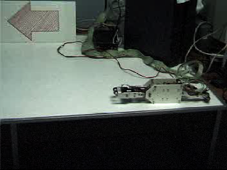
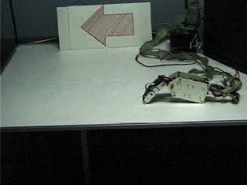
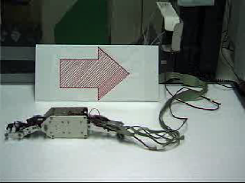
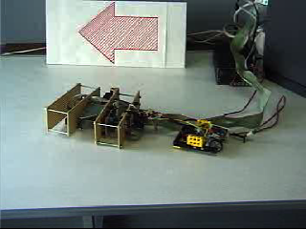
Example: Hajime Kimura’s RL Robots
Before
After
Slide Credit: Rich Sutton
Backward
New Robot, Same algorithm

Slide 8
The RL Interface
Agent
State,
Stimulus,
Situation
Reward,
Gain, Payoff,
Cost
Action,
Response,
Control
Environment
(world)
Environment may be unknown, nonlinear, stochastic and complex
Agent learns a policy mapping states to actions
Seeking to maximize its cumulative reward in the long run
Notes:
Agent and environment interact in real-time, continually learning and improving

Slide 9
Signature challenges of RL
Evaluative feedback (reward)
Sequentiality, delayed consequences
Need for trial and error, to explore as well as exploit
Non-stationarity
The fleeting nature of time and online data
Slide Credit: Rich Sutton

Slide 10
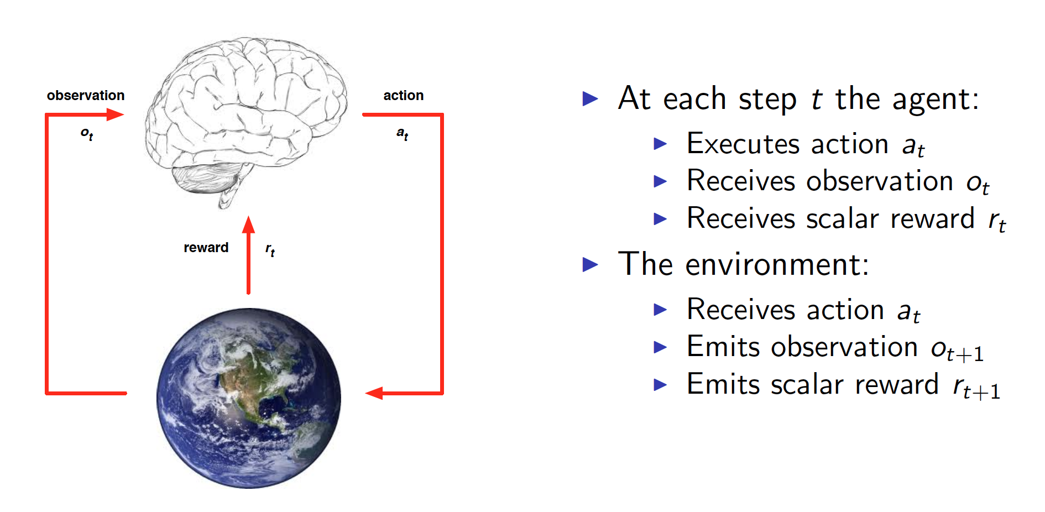
RL API
Slide Credit: David Silver

Slide 11
State

Slide 12
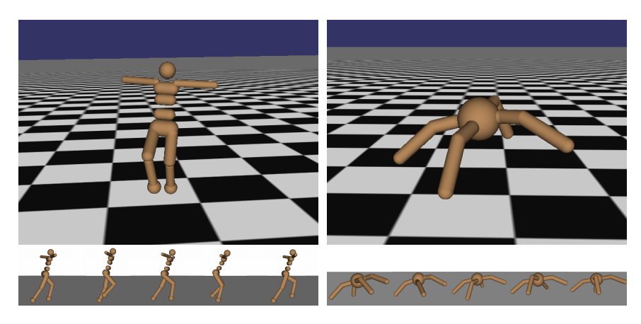
Robot Locomotion
Objective: Make the robot move forward
State: Angle and position of the joints
Action: Torques applied on joints
Reward: 1 at each time step upright + forward movement
Figures copyright John Schulman et al., 2016. Reproduced with permission.
Slide Credit: Fei-Fei Li, Justin Johnson, Serena Yeung, CS 231n

Slide 13
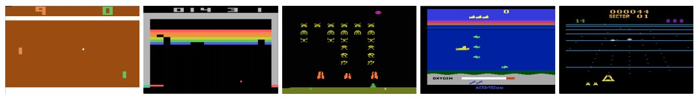
Atari Games
Objective: Complete the game with the highest score
State: Raw pixel inputs of the game state
Action: Game controls e.g. Left, Right, Up, Down
Reward: Score increase/decrease at each time step
Figures copyright Volodymyr Mnih et al., 2013. Reproduced with permission.
Slide Credit: Fei-Fei Li, Justin Johnson, Serena Yeung, CS 231n
Notes:
Games are also a big class of problems that can be formulated with RL
For example here we have atari games, which are a class success of deep RL

Slide 14
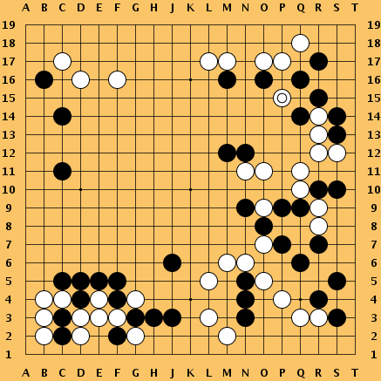
Go
Objective: Win the game!
State: Position of all pieces
Action: Where to put the next piece down
Reward: 1 if win at the end of the game, 0 otherwise
This image is CC0 public domain
Slide Credit: Fei-Fei Li, Justin Johnson, Serena Yeung, CS 231n
Notes:
Something that was a huge achievement last year when DeepMind’s AlphaGo beat Lee Sedol, the best Go player of the last few years, and just last night, competing again

Slide 15
Demo

Slide 16
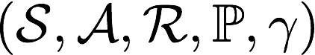
Markov Decision Process
Mathematical formulation of the RL problem
Defined by:
: set of possible states
: set of possible actions
: distribution of reward given (state, action) pair
: transition probability i.e. distribution over next state given (state, action) pair
: discount factor
Slide Credit: Fei-Fei Li, Justin Johnson, Serena Yeung, CS 231n
Notes:
MDP satisfies Markov property
Define by tuple of objects

Slide 17
Markov Decision Process
Mathematical formulation of the RL problem
Life is trajectory:
Defined by:
: set of possible states
: set of possible actions
: distribution of reward given (state, action) pair
: transition probability i.e. distribution over next state given (state, action) pair
: discount factor
Slide Credit: Fei-Fei Li, Justin Johnson, Serena Yeung, CS 231n
Notes:
MDP satisfies Markov property
Define by tuple of objects

Slide 18
Markov Decision Process
Mathematical formulation of the RL problem
Life is trajectory:
Markov property: Current state completely characterizes the state of the world
Defined by:
: set of possible states
: set of possible actions
: distribution of reward given (state, action) pair
: transition probability i.e. distribution over next state given (state, action) pair
: discount factor
Slide Credit: Fei-Fei Li, Justin Johnson, Serena Yeung, CS 231n
Notes:
MDP satisfies Markov property
Define by tuple of objects

Slide 19
Components of an RL Agent
Policy
How does an agent behave?
Value function
How good is each state and/or state-action pair?
Model
Agent’s representation of the environment

Slide 20
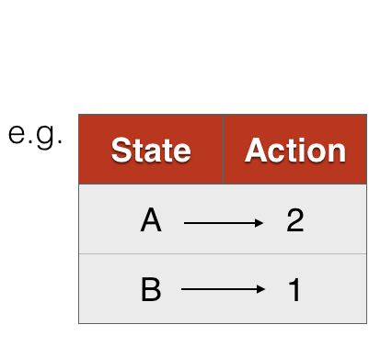
Policy
A policy is how the agent acts
Formally, map from states to actions

Slide 21
The optimal policy 𝝿*
What’s a good policy?
Notes:
Can work with maximizing the expected sum of rewards

Slide 22
The optimal policy 𝝿*
What’s a good policy?
Maximizes current reward? Sum of all future reward?
Notes:
Can work with maximizing the expected sum of rewards

Slide 23
The optimal policy 𝝿*
What’s a good policy?
Maximizes current reward? Sum of all future reward?
Discounted future rewards!
Notes:
Can work with maximizing the expected sum of rewards

Slide 24
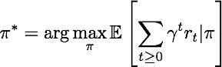
The optimal policy 𝝿*
What’s a good policy?
Maximizes current reward? Sum of all future reward?
Discounted future rewards!
Formally:
with
Notes:
Can work with maximizing the expected sum of rewards

Slide 25
Value Function
A value function is a prediction of future reward
“State Value Function” or simply “Value Function”
How good is a state?
Am I screwed? Am I winning this game?
“Action Value Function” or Q-function
How good is a state action-pair?
Should I do this now?

Slide 26
Definitions: Value function and Q-value function
Following a policy produces sample trajectories (or paths) s₀, a₀, r₀, s₁, a₁, r₁, …
Slide Credit: Fei-Fei Li, Justin Johnson, Serena Yeung, CS 231n

Slide 27
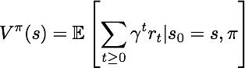
Definitions: Value function and Q-value function
Following a policy produces sample trajectories (or paths) s₀, a₀, r₀, s₁, a₁, r₁, …
How good is a state?
The value function at state s, is the expected cumulative reward from state s (and following the policy thereafter):
Slide Credit: Fei-Fei Li, Justin Johnson, Serena Yeung, CS 231n

Slide 28
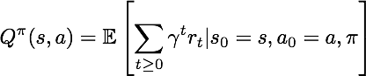
Definitions: Value function and Q-value function
Following a policy produces sample trajectories (or paths) s₀, a₀, r₀, s₁, a₁, r₁, …
How good is a state?
The value function at state s, is the expected cumulative reward from state s (and following the policy thereafter):
How good is a state-action pair?
The Q-value function at state s and action a, is the expected cumulative reward from taking action a in state s (and following the policy thereafter):
Slide Credit: Fei-Fei Li, Justin Johnson, Serena Yeung, CS 231n

Slide 29
Model
Slide Credit: David Silver

Slide 30
Model
Model predicts what the world will do next
Slide Credit: David Silver

Slide 31
Maze Example
Slide Credit: David Silver

Slide 32
Maze Example: Policy
Slide Credit: David Silver

Slide 33
Maze Example: Value
Slide Credit: David Silver

Slide 34
Maze Example: Model
Slide Credit: David Silver

Slide 35
Components of an RL Agent
Value function
How good is each state and/or state-action pair?
Policy
How does an agent behave?
Model
Agent’s representation of the environment

Slide 36
Approaches to RL
Value-based RL
Estimate the optimal action-value function
Policy-based RL
Search directly for the optimal policy
Model
Build a model of the world
State transition, reward probabilities
Plan (e.g. by look-ahead) using model

Slide 37
Deep RL
Value-based RL
Use neural nets to represent Q function
Policy-based RL
Use neural nets to represent policy
Model
Use neural nets to represent and learn the model

Slide 38
Approaches to RL
Value-based RL
Estimate the optimal action-value function

Slide 39
Optimal Value Function
Optimal Q-function is the maximum achievable value
Slide Credit: David Silver

Slide 40
Optimal Value Function
Optimal Q-function is the maximum achievable value
Once we have it, we can act optimally
Slide Credit: David Silver

Slide 41
Optimal Value Function
Optimal value maximizes over all future decisions
Slide Credit: David Silver

Slide 42
Optimal Value Function
Optimal value maximizes over all future decisions
Formally, Q* satisfies Bellman Equations
Slide Credit: David Silver

Slide 43
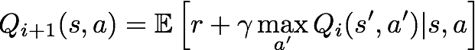
Solving for the optimal policy
Value iteration algorithm: Use Bellman equation as an iterative update
Q_{i} will converge to Q* as i -> infinity
Slide Credit: Fei-Fei Li, Justin Johnson, Serena Yeung, CS 231n
Notes:
At each step you’re going to refine your approximation of Q* by trying to enforce the Bellman equation
Under some mathematical conditions, the sequence Qi will converge to Q* as i -> infinity

Slide 44
Solving for the optimal policy
Value iteration algorithm: Use Bellman equation as an iterative update
Q_{i} will converge to Q* as i -> infinity
What’s the problem with this?
Slide Credit: Fei-Fei Li, Justin Johnson, Serena Yeung, CS 231n

Slide 45
Solving for the optimal policy
Value iteration algorithm: Use Bellman equation as an iterative update
Q_{i} will converge to Q* as i -> infinity
What’s the problem with this?
Not scalable. Must compute Q(s,a) for every state-action pair. If state is e.g. current game state pixels, computationally infeasible to compute for entire state space!
Slide Credit: Fei-Fei Li, Justin Johnson, Serena Yeung, CS 231n

Slide 46
Solving for the optimal policy
Value iteration algorithm: Use Bellman equation as an iterative update
Q_{i} will converge to Q* as i -> infinity
What’s the problem with this?
Not scalable. Must compute Q(s,a) for every state-action pair. If state is e.g. current game state pixels, computationally infeasible to compute for entire state space!
Solution: use a function approximator to estimate Q(s,a). E.g. a neural network!
Slide Credit: Fei-Fei Li, Justin Johnson, Serena Yeung, CS 231n

Slide 47
Demo
http://cs.stanford.edu/people/karpathy/reinforcejs/gridworld_td.html

Slide 48
Deep RL
Value-based RL
Use neural nets to represent Q function
Policy-based RL
Use neural nets to represent policy
Model
Use neural nets to represent and learn the model

Slide 49
Q-Networks
Slide Credit: David Silver

Slide 50
Case Study: Playing Atari Games
[Mnih et al. NIPS Workshop 2013; Nature 2015]
Objective: Complete the game with the highest score
State: Raw pixel inputs of the game state
Action: Game controls e.g. Left, Right, Up, Down
Reward: Score increase/decrease at each time step
Figures copyright Volodymyr Mnih et al., 2013. Reproduced with permission.
Slide Credit: Fei-Fei Li, Justin Johnson, Serena Yeung, CS 231n

Slide 51
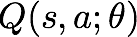
Q-network Architecture
[Mnih et al. NIPS Workshop 2013; Nature 2015]
:
neural network
with weights
FC-4 (Q-values)
FC-256
32 4x4 conv, stride 2
16 8x8 conv, stride 4
Current state s_{t}: 84x84x4 stack of last 4 frames
(after RGB->grayscale conversion, downsampling, and cropping)
Slide Credit: Fei-Fei Li, Justin Johnson, Serena Yeung, CS 231n
Notes:
Network that we’re going to use for our Q function

Slide 52
Q-network Architecture
[Mnih et al. NIPS Workshop 2013; Nature 2015]
:
neural network
with weights
FC-4 (Q-values)
FC-256
32 4x4 conv, stride 2
16 8x8 conv, stride 4
Input: state s_{t}
Current state s_{t}: 84x84x4 stack of last 4 frames
(after RGB->grayscale conversion, downsampling, and cropping)
Slide Credit: Fei-Fei Li, Justin Johnson, Serena Yeung, CS 231n

Slide 53
Q-network Architecture
[Mnih et al. NIPS Workshop 2013; Nature 2015]
:
neural network
with weights
FC-4 (Q-values)
FC-256
Familiar conv layers, FC layer
32 4x4 conv, stride 2
16 8x8 conv, stride 4
Current state s_{t}: 84x84x4 stack of last 4 frames
(after RGB->grayscale conversion, downsampling, and cropping)
Slide Credit: Fei-Fei Li, Justin Johnson, Serena Yeung, CS 231n

Slide 54
Q-network Architecture
[Mnih et al. NIPS Workshop 2013; Nature 2015]
:
neural network
with weights
Last FC layer has 4-d output (if 4 actions), corresponding to Q(s_{t}, a₁), Q(s_{t}, a₂), Q(s_{t}, a₃), Q(s_{t},a₄)
FC-4 (Q-values)
FC-256
32 4x4 conv, stride 2
16 8x8 conv, stride 4
Current state s_{t}: 84x84x4 stack of last 4 frames
(after RGB->grayscale conversion, downsampling, and cropping)
Slide Credit: Fei-Fei Li, Justin Johnson, Serena Yeung, CS 231n
Notes:
Corresponding to one scalar value for each of our actions

Slide 55
Q-network Architecture
[Mnih et al. NIPS Workshop 2013; Nature 2015]
:
neural network
with weights
Last FC layer has 4-d output (if 4 actions), corresponding to Q(s_{t}, a₁), Q(s_{t}, a₂), Q(s_{t}, a₃), Q(s_{t},a₄)
FC-4 (Q-values)
FC-256
32 4x4 conv, stride 2
16 8x8 conv, stride 4
Number of actions between 4-18 depending on Atari game
Current state s_{t}: 84x84x4 stack of last 4 frames
(after RGB->grayscale conversion, downsampling, and cropping)
Slide Credit: Fei-Fei Li, Justin Johnson, Serena Yeung, CS 231n

Slide 56
Q-network Architecture
[Mnih et al. NIPS Workshop 2013; Nature 2015]
:
neural network
with weights
Last FC layer has 4-d output (if 4 actions), corresponding to Q(s_{t}, a₁), Q(s_{t}, a₂), Q(s_{t}, a₃), Q(s_{t},a₄)
FC-4 (Q-values)
FC-256
A single feedforward pass to compute Q-values for all actions from the current state => efficient!
32 4x4 conv, stride 2
16 8x8 conv, stride 4
Number of actions between 4-18 depending on Atari game
Current state s_{t}: 84x84x4 stack of last 4 frames
(after RGB->grayscale conversion, downsampling, and cropping)
Slide Credit: Fei-Fei Li, Justin Johnson, Serena Yeung, CS 231n

Slide 57
Deep Q-learning
Remember: want to find a Q-function that satisfies the Bellman Equation:
Slide Credit: Fei-Fei Li, Justin Johnson, Serena Yeung, CS 231n
Notes:
Effect as we take gradient steps is to iteratively try to make the Q-value close to the target value

Slide 58
Deep Q-learning
Remember: want to find a Q-function that satisfies the Bellman Equation:
Forward Pass
Loss function:
Slide Credit: Fei-Fei Li, Justin Johnson, Serena Yeung, CS 231n
Notes:
Effect as we take gradient steps is to iteratively try to make the Q-value close to the target value

Slide 59
Deep Q-learning
Remember: want to find a Q-function that satisfies the Bellman Equation:
Forward Pass
Loss function:
where
Slide Credit: Fei-Fei Li, Justin Johnson, Serena Yeung, CS 231n
Notes:
Effect as we take gradient steps is to iteratively try to make the Q-value close to the target value

Slide 60
Deep Q-learning
Remember: want to find a Q-function that satisfies the Bellman Equation:
Forward Pass
Loss function:
where
Backward Pass
Gradient update (with respect to Q-function parameters θ):
Slide Credit: Fei-Fei Li, Justin Johnson, Serena Yeung, CS 231n
Notes:
Effect as we take gradient steps is to iteratively try to make the Q-value close to the target value

Slide 61
Deep Q-learning
Remember: want to find a Q-function that satisfies the Bellman Equation:
Forward Pass
Loss function:
where
Iteratively try to make the Q-value close to the target value (y_{i}) it should have, if Q-function corresponds to optimal Q* (and optimal policy 𝝿*)
Backward Pass
Gradient update (with respect to Q-function parameters θ):
Slide Credit: Fei-Fei Li, Justin Johnson, Serena Yeung, CS 231n
Notes:
Effect as we take gradient steps is to iteratively try to make the Q-value close to the target value

Slide 62
Training the Q-network: Experience Replay
[Mnih et al. NIPS Workshop 2013; Nature 2015]
Learning from batches of consecutive samples is problematic:
Samples are correlated => inefficient learning
Current Q-network parameters determines next training samples (e.g. if maximizing action is to move left, training samples will be dominated by samples from left-hand size) => can lead to bad feedback loops

Slide 63
Training the Q-network: Experience Replay
[Mnih et al. NIPS Workshop 2013; Nature 2015]
Learning from batches of consecutive samples is problematic:
Samples are correlated => inefficient learning
Current Q-network parameters determines next training samples (e.g. if maximizing action is to move left, training samples will be dominated by samples from left-hand size) => can lead to bad feedback loops
Address these problems using experience replay
Continually update a replay memory table of transitions (s_{t}, a_{t}, r_{t}, s_{t+1}) as game (experience) episodes are played
Train Q-network on random minibatches of transitions from the replay memory, instead of consecutive samples

Slide 64
Experience Replay
Slide Credit: David Silver

Slide 65
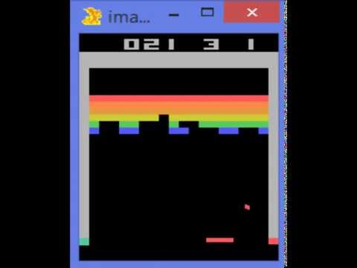
https://www.youtube.com/watch?v=V1eYniJ0Rnk
Video by Károly Zsolnai-Fehér. Reproduced with permission.
Slide Credit: Fei-Fei Li, Justin Johnson, Serena Yeung, CS 231n

Slide 66
Deep RL
Value-based RL
Use neural nets to represent Q function
Policy-based RL
Use neural nets to represent policy
Model
Use neural nets to represent and learn the model

Slide 67
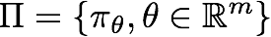
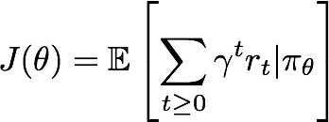
Policy Gradients
Formally, let’s define a class of parameterized policies:
For each policy, define its value:
Slide Credit: Fei-Fei Li, Justin Johnson, Serena Yeung, CS 231n

Slide 68
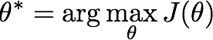
Policy Gradients
Formally, let’s define a class of parameterized policies:
For each policy, define its value:
We want to find the optimal policy
How can we do this?
Slide Credit: Fei-Fei Li, Justin Johnson, Serena Yeung, CS 231n

Slide 69
Policy Gradients
Formally, let’s define a class of parameterized policies:
For each policy, define its value:
We want to find the optimal policy
How can we do this?
Gradient ascent on policy parameters!
Slide Credit: Fei-Fei Li, Justin Johnson, Serena Yeung, CS 231n

Slide 70
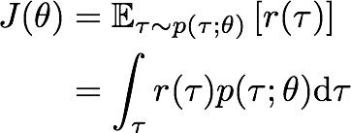
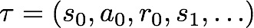
REINFORCE algorithm
Mathematically, we can write:
Where r(𝜏) is the reward of a trajectory
Slide Credit: Fei-Fei Li, Justin Johnson, Serena Yeung, CS 231n
Notes:
Let’s talk about how we’re going to do this, which we’re going to call the reinforce algorithm
We’re going to sample trajectories of experience s0,a0,r0, s1, and so on, with our policy pi_theta
For each trajectory, we can compute a reward for that trajectory
and the value of a policy pi_theta will just be the expected reward of these trajectories that come from following pi_theta

Slide 71
REINFORCE algorithm
Expected reward:
Slide Credit: Fei-Fei Li, Justin Johnson, Serena Yeung, CS 231n

Slide 72
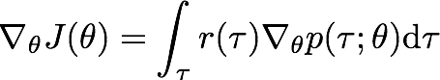
REINFORCE algorithm
Expected reward:
Now let’s differentiate this:
Slide Credit: Fei-Fei Li, Justin Johnson, Serena Yeung, CS 231n
Notes:
Want to do gradient ascent, so let’s differentiate this

Slide 73
REINFORCE algorithm
Expected reward:
Now let’s differentiate this:
Intractable! Expectation of gradient is problematic when p depends on θ
Slide Credit: Fei-Fei Li, Justin Johnson, Serena Yeung, CS 231n

Slide 74
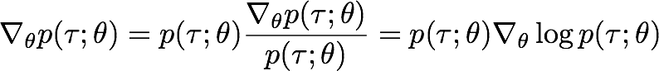
REINFORCE algorithm
Expected reward:
Now let’s differentiate this:
However, we can use a nice trick:
Intractable! Expectation of gradient is problematic when p depends on θ
Slide Credit: Fei-Fei Li, Justin Johnson, Serena Yeung, CS 231n

Slide 75
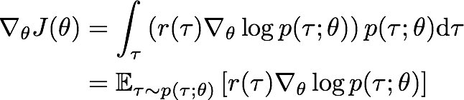
REINFORCE algorithm
Expected reward:
Now let’s differentiate this:
However, we can use a nice trick:
If we inject this back:
Intractable! Expectation of gradient is problematic when p depends on θ
Can estimate with Monte Carlo sampling
Slide Credit: Fei-Fei Li, Justin Johnson, Serena Yeung, CS 231n
Notes:
Core idea of reinforce
Transform a gradient of an expectation into an expectation of gradients
Can now estimate our gradient using sample trajectories

Slide 76
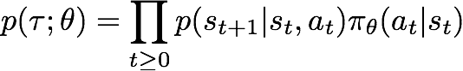
REINFORCE algorithm
Can we compute those quantities without knowing the transition probabilities?
We have:
Slide Credit: Fei-Fei Li, Justin Johnson, Serena Yeung, CS 231n

Slide 77
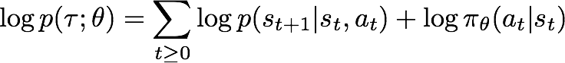
REINFORCE algorithm
Can we compute those quantities without knowing the transition probabilities?
We have:
Thus:
Slide Credit: Fei-Fei Li, Justin Johnson, Serena Yeung, CS 231n

Slide 78
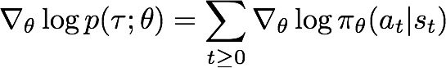
REINFORCE algorithm
Can we compute those quantities without knowing the transition probabilities?
We have:
Thus:
And when differentiating:
Doesn’t depend on transition probabilities!
Slide Credit: Fei-Fei Li, Justin Johnson, Serena Yeung, CS 231n

Slide 79
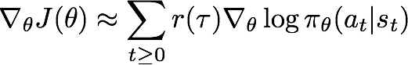
REINFORCE algorithm
Can we compute those quantities without knowing the transition probabilities?
We have:
Thus:
And when differentiating:
Therefore when sampling a trajectory 𝜏, we can estimate J(𝜃) with
Doesn’t depend on transition probabilities!
Slide Credit: Fei-Fei Li, Justin Johnson, Serena Yeung, CS 231n

Slide 80
Intuition
Gradient estimator:
Interpretation:
If r(𝜏) is high, push up the probabilities of the actions seen
If r(𝜏) is low, push down the probabilities of the actions seen
Slide Credit: Fei-Fei Li, Justin Johnson, Serena Yeung, CS 231n

Slide 81
Intuition
Gradient estimator:
Interpretation:
If r(𝜏) is high, push up the probabilities of the actions seen
If r(𝜏) is low, push down the probabilities of the actions seen
Might seem simplistic to say that if a trajectory is good then all its actions were good. But in expectation, it averages out!
Slide Credit: Fei-Fei Li, Justin Johnson, Serena Yeung, CS 231n

Slide 82
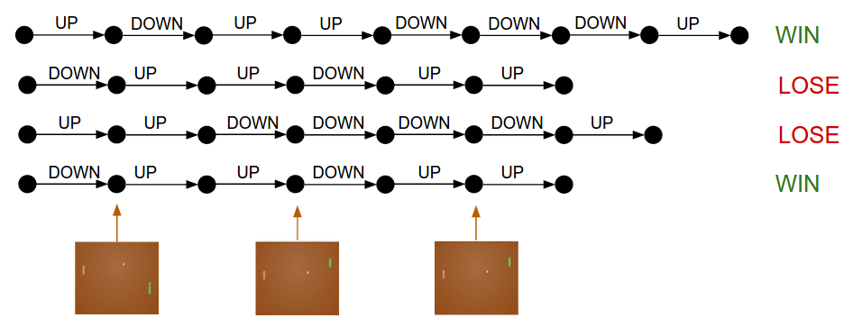
Intuition

Slide 83
Intuition
Gradient estimator:
Interpretation:
If r(𝜏) is high, push up the probabilities of the actions seen
If r(𝜏) is low, push down the probabilities of the actions seen
Might seem simplistic to say that if a trajectory is good then all its actions were good. But in expectation, it averages out!
However, this also suffers from high variance because credit assignment is really hard. Can we help the estimator?
Slide Credit: Fei-Fei Li, Justin Johnson, Serena Yeung, CS 231n

Slide 84
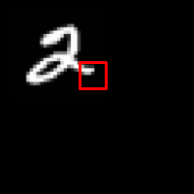
REINFORCE in action: Recurrent Attention Model (RAM)
Objective: Image Classification
Take a sequence of “glimpses” selectively focusing on regions of the image, to predict class
Inspiration from human perception and eye movements
Saves computational resources => scalability
Able to ignore clutter / irrelevant parts of image
State: Glimpses seen so far
Action: (x,y) coordinates (center of glimpse) of where to look next in image
Reward: 1 at the final timestep if image correctly classified, 0 otherwise
glimpse
[Mnih et al. 2014]
Slide Credit: Fei-Fei Li, Justin Johnson, Serena Yeung, CS 231n
Notes:
Selectively focus on parts of the image, build up information as you look around

Slide 85
REINFORCE in action: Recurrent Attention Model (RAM)
Objective: Image Classification
Take a sequence of “glimpses” selectively focusing on regions of the image, to predict class
Inspiration from human perception and eye movements
Saves computational resources => scalability
Able to ignore clutter / irrelevant parts of image
State: Glimpses seen so far
Action: (x,y) coordinates (center of glimpse) of where to look next in image
Reward: 1 at the final timestep if image correctly classified, 0 otherwise
glimpse
Glimpsing is a non-differentiable operation => learn policy for how to take glimpse actions using REINFORCE
Given state of glimpses seen so far, use RNN to model the state and output next action
[Mnih et al. 2014]
Slide Credit: Fei-Fei Li, Justin Johnson, Serena Yeung, CS 231n
Notes:
Selectively focus on parts of the image, build up information as you look around

Slide 86
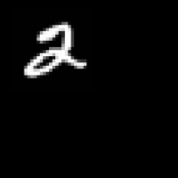

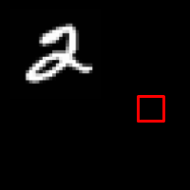
REINFORCE in action: Recurrent Attention Model (RAM)
(x₁, y₁)
Input image
NN
[Mnih et al. 2014]
Slide Credit: Fei-Fei Li, Justin Johnson, Serena Yeung, CS 231n

Slide 87
REINFORCE in action: Recurrent Attention Model (RAM)
(x₁, y₁)
(x₂, y₂)
Input image
NN
NN
[Mnih et al. 2014]
Slide Credit: Fei-Fei Li, Justin Johnson, Serena Yeung, CS 231n

Slide 88
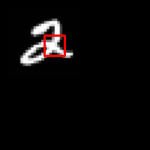
REINFORCE in action: Recurrent Attention Model (RAM)
(x₁, y₁)
(x₂, y₂)
(x₃, y₃)
Input image
NN
NN
NN
[Mnih et al. 2014]
Slide Credit: Fei-Fei Li, Justin Johnson, Serena Yeung, CS 231n

Slide 89
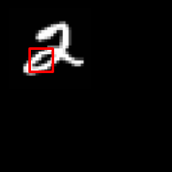
REINFORCE in action: Recurrent Attention Model (RAM)
(x₁, y₁)
(x₂, y₂)
(x₃, y₃)
(x₄, y₄)
Input image
NN
NN
NN
NN
[Mnih et al. 2014]
Slide Credit: Fei-Fei Li, Justin Johnson, Serena Yeung, CS 231n

Slide 90
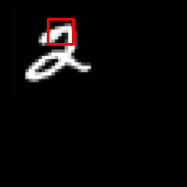
REINFORCE in action: Recurrent Attention Model (RAM)
(x₁, y₁)
(x₂, y₂)
(x₃, y₃)
(x₄, y₄)
(x₅, y₅)
Softmax
Input image
NN
y=2
NN
NN
NN
NN
[Mnih et al. 2014]
Slide Credit: Fei-Fei Li, Justin Johnson, Serena Yeung, CS 231n

Slide 91

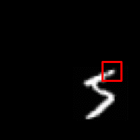
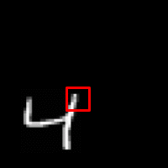
REINFORCE in action: Recurrent Attention Model (RAM)
Has also been used in many other tasks including fine-grained image recognition, image captioning, and visual question-answering!
Figures copyright Daniel Levy, 2017. Reproduced with permission.
[Mnih et al. 2014]
Slide Credit: Fei-Fei Li, Justin Johnson, Serena Yeung, CS 231n

Slide 92
Intuition
Gradient estimator:
Interpretation:
If r(𝜏) is high, push up the probabilities of the actions seen
If r(𝜏) is low, push down the probabilities of the actions seen
Might seem simplistic to say that if a trajectory is good then all its actions were good. But in expectation, it averages out!
However, this also suffers from high variance because credit assignment is really hard. Can we help the estimator?
Slide Credit: Fei-Fei Li, Justin Johnson, Serena Yeung, CS 231n

Slide 93
Variance reduction
Gradient estimator:
Slide Credit: Fei-Fei Li, Justin Johnson, Serena Yeung, CS 231n

Slide 94
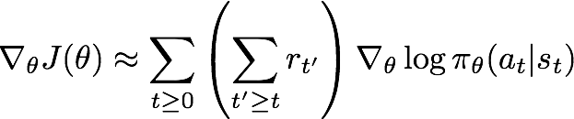
Variance reduction
Gradient estimator:
First idea: Push up probabilities of an action seen, only by the cumulative future reward from that state
Slide Credit: Fei-Fei Li, Justin Johnson, Serena Yeung, CS 231n
Notes:
How good an action is is only given by how much future reward it generates

Slide 95
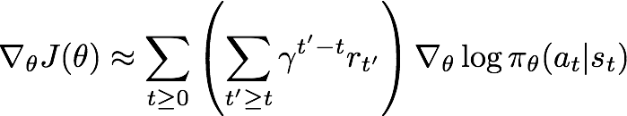
Variance reduction
Gradient estimator:
First idea: Push up probabilities of an action seen, only by the cumulative future reward from that state
Second idea: Use discount factor 𝛾 to ignore delayed effects
Slide Credit: Fei-Fei Li, Justin Johnson, Serena Yeung, CS 231n
Notes:
How good an action is, is computed only by rewards coming soon after it, based on the gamma weighting

Slide 96
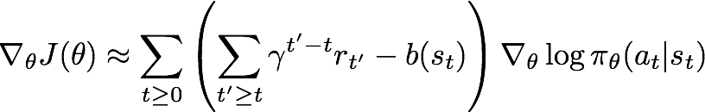
Variance reduction: Baseline
Problem: The raw value of a trajectory isn’t necessarily meaningful. For example, if rewards are all positive, you keep pushing up probabilities of actions.
What is important then? Whether a reward is better or worse than what you expect to get
Idea: Introduce a baseline function dependent on the state.
Concretely, estimator is now:
Slide Credit: Fei-Fei Li, Justin Johnson, Serena Yeung, CS 231n
Notes:
3rd idea is the idea of having a baseline
Problem with what we’ve been doing so far is...

Slide 97
How to choose the baseline?
A simple baseline: constant moving average of rewards experienced so far from all trajectories
Slide Credit: Fei-Fei Li, Justin Johnson, Serena Yeung, CS 231n

Slide 98
How to choose the baseline?
A simple baseline: constant moving average of rewards experienced so far from all trajectories
Variance reduction techniques seen so far are typically used in “Vanilla REINFORCE”
Slide Credit: Fei-Fei Li, Justin Johnson, Serena Yeung, CS 231n
Notes:
Looking at cumulative future reward
Discount factor
Simple baselines

Slide 99
How to choose the baseline?
A better baseline: Want to push up the probability of an action from a state, if this action was better than the expected value of what we should get from that state.
Q: What does this remind you of?
Slide Credit: Fei-Fei Li, Justin Johnson, Serena Yeung, CS 231n

Slide 100
How to choose the baseline?
A better baseline: Want to push up the probability of an action from a state, if this action was better than the expected value of what we should get from that state.
Q: What does this remind you of?
A: Q-function and value function!
Slide Credit: Fei-Fei Li, Justin Johnson, Serena Yeung, CS 231n

Slide 101
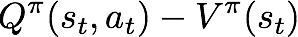
How to choose the baseline?
A better baseline: Want to push up the probability of an action from a state, if this action was better than the expected value of what we should get from that state.
Q: What does this remind you of?
A: Q-function and value function!
Intuitively, we are happy with an action a_{t} in a state s_{t} if is large. On the contrary, we are unhappy with an action if it’s small.
Slide Credit: Fei-Fei Li, Justin Johnson, Serena Yeung, CS 231n

Slide 102
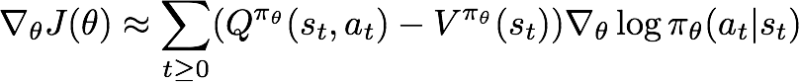
How to choose the baseline?
A better baseline: Want to push up the probability of an action from a state, if this action was better than the expected value of what we should get from that state.
Q: What does this remind you of?
A: Q-function and value function!
Intuitively, we are happy with an action a_{t} in a state s_{t} if is large. On the contrary, we are unhappy with an action if it’s small.
Using this, we get the estimator:
Slide Credit: Fei-Fei Li, Justin Johnson, Serena Yeung, CS 231n

Slide 103
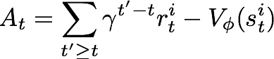
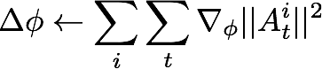
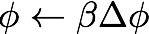
Actor-Critic Algorithm
Initialize policy parameters 𝜃, critic parameters 𝜙
For iteration=1, 2 … do
Sample m trajectories under the current policy
For i=1, …, m do
For t=1, ... , T do
End for
Slide Credit: Fei-Fei Li, Justin Johnson, Serena Yeung, CS 231n

Slide 104
Summary
Policy gradients: very general but suffer from high variance so requires a lot of samples. Challenge: sample-efficiency
Q-learning: does not always work but when it works, usually more sample-efficient. Challenge: exploration
Guarantees:
Policy Gradients: Converges to a local minima of J(𝜃), often good enough!
Q-learning: Zero guarantees since you are approximating Bellman equation with a complicated function approximator
Slide Credit: Fei-Fei Li, Justin Johnson, Serena Yeung, CS 231n

